Slide 1
The Common Core State standards
What Does it Mean for Our School?
Notes:
2 mins.
Introduction/welcome

Slide 2
Today’s Objectives:
To develop an awareness and understanding of the Common Core State Standards.
To learn ways to support your child at home.
To understand how students will be evaluated on their progress of the standards via the report card.
Notes:
1 min.

Slide 3
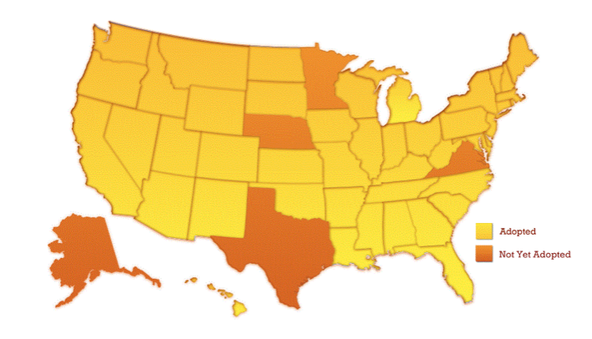
Common Core Across the Nation
Notes:
3 mins.
Whereas each state previously had its own set of expectations, which resulted in potentially significant differences in student learning from state to state, 46 states and DC have now adopted the Common Core State Standards. In addition, Guam, the U.S. Virgin Islands, the American Samoa Islands, and the Mariana Islands have also freely adopted the Standards.
This is not a political initiative. Each state has the authority to adopt standards. To have 46 states come together, regardless of their political affiliation, and agree on what’s best for education in America is no small feat.

Slide 4
Building knowledge through content-rich nonfiction
Reading, writing, and speaking grounded in evidence from text, both literally and informational
Regular practice with complex text and its academic language
Notes:
2 mins.
As we think about what it takes to help students become ready for college and careers, there are major changes, or “shifts,” in the way teachers will teach. The shifts represent what the standards now expect students to learn and teachers to teach. They are the headlines that describe some of what will change.

Slide 5
Notes:
5 mins.
These are ideas for supporting students with the Common Core shifts in ELA/Literacy at home.
As students read, parents can read the same material and have conversations with their children that are focused on the text.
Give children multiple opportunities to engage in reading about things that interest them – especially informational texts (biographies, historical non-fiction, hobbies, sports, science topics, etc.) If your children are interested in games, have them read information about who invented the game, when it was invented, or have them explain step by step procedures to make their games operate in a certain manner. If they are interested in different historical figures, athletes, or science topics, encourage them to read books or articles that relate to those people.
As children inquire about different concepts or become curious about certain topics, encourage them to research their own questions by doing a web search and reading news articles or books that help them to find out new information.
Take a moment to ask participants if they have any questions on how to support their child.

Slide 6
Focus: Focus strongly where the standards focus
Coherence: Think across grades, and link to major topics
Rigor: In major topics, pursue conceptual understanding, procedural skill and fluency, and application with equal intensity
Notes:
2 mins.
ELA/Literacy, there are also “headline changes” in expectations and instruction for math. These 3 shifts demonstrate the ways in which teaching and learning will change with Common Core State Standards to help students achieve their goals of college and career readiness.

Slide 7
Notes:
5 mins.
These are some ideas to support children at home with the Common Core shifts in math.
Working with your child on basic math facts such as addition, subtraction, multiplication, and division will help to improve student’s speed and accuracy in math. This could involve a variety of opportunities from flash cards to games including dice and cards.
Encourage your child not to give up on math problems, but finish them to completion. This will help build their stamina for solving multi-step problems that they will be required to engage in at school. Encourage children to engage in math games or test their skills with online math challenges that are timed.
Many student can get the answers to their math problems, but have a difficult time explaining their thinking behind the answer. Encouraging your child to talk the math out and show their work or thinking helps them to demonstrate their conceptual understanding of math.
Helping children to see math in action at home creates a real-world experience and application for math skills. Try measuring ingredients, measuring objects around the house, calculating the area of a room to input furniture, analyzing sports statistics, etc.
Take a moment to ask participants if they have any questions on how to support their child

Slide 8
What does this mean for the report card?
Notes:
1 min.

Slide 9
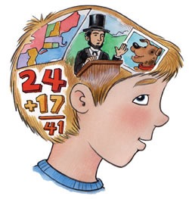
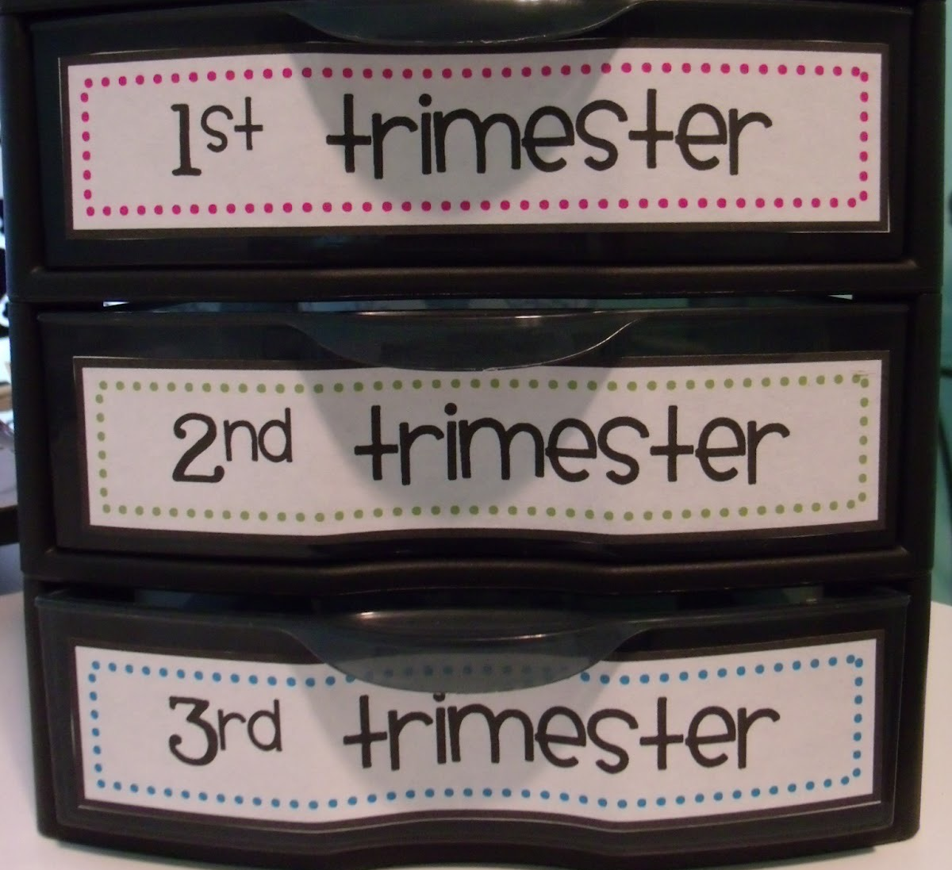
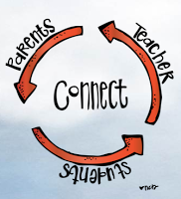
Standards-Based Report Card
Communication tool
Mastery of Standards
Know and are able to do
Progress at a given time
Notes:
2 min
What is a standards-based report card?
Explain that we have a standards based report card. This means that grades are given based on mastery of standards. Students have until the end of the year to master the standard.
Explain that when we grade students we do it in relation to the standards. The standard is the end goal. It's where the student is at the end of each trimester.
Ultimate goal is for all students to be meeting all grade level standards by the end of the grade level. (end of school year)
Report card serves as a communication tool for parents

Slide 10
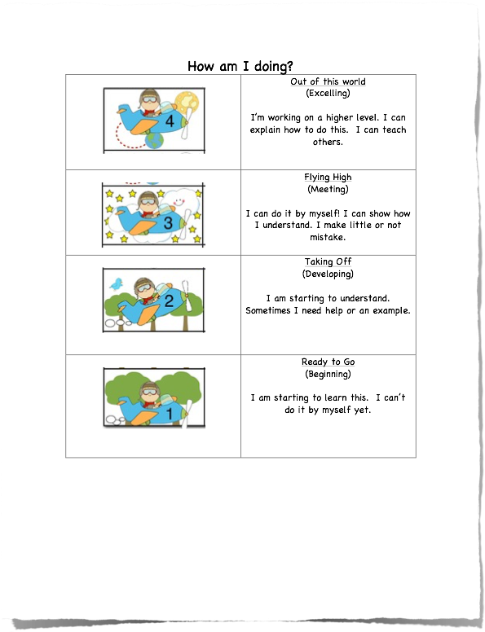
Report Card Grading Key
Notes:
2 min
Translate the grading key of 4, 3, 2, 1:
4: Excels at Grade Level Standard - Consistently understands and applies key concepts, processes and skills for grade level standards.
3: Meets Grade Level Standard - Usually understands and applies key concepts, processes and skills for grade level standards.
2: Approaching Grade Level Standard - Beginning to understand and apply key concepts, processes, and skills for grade level standards.
1: Below Grade Level Standard - Does not understand and apply key concepts, processes and skills for grade level standards.

Slide 11
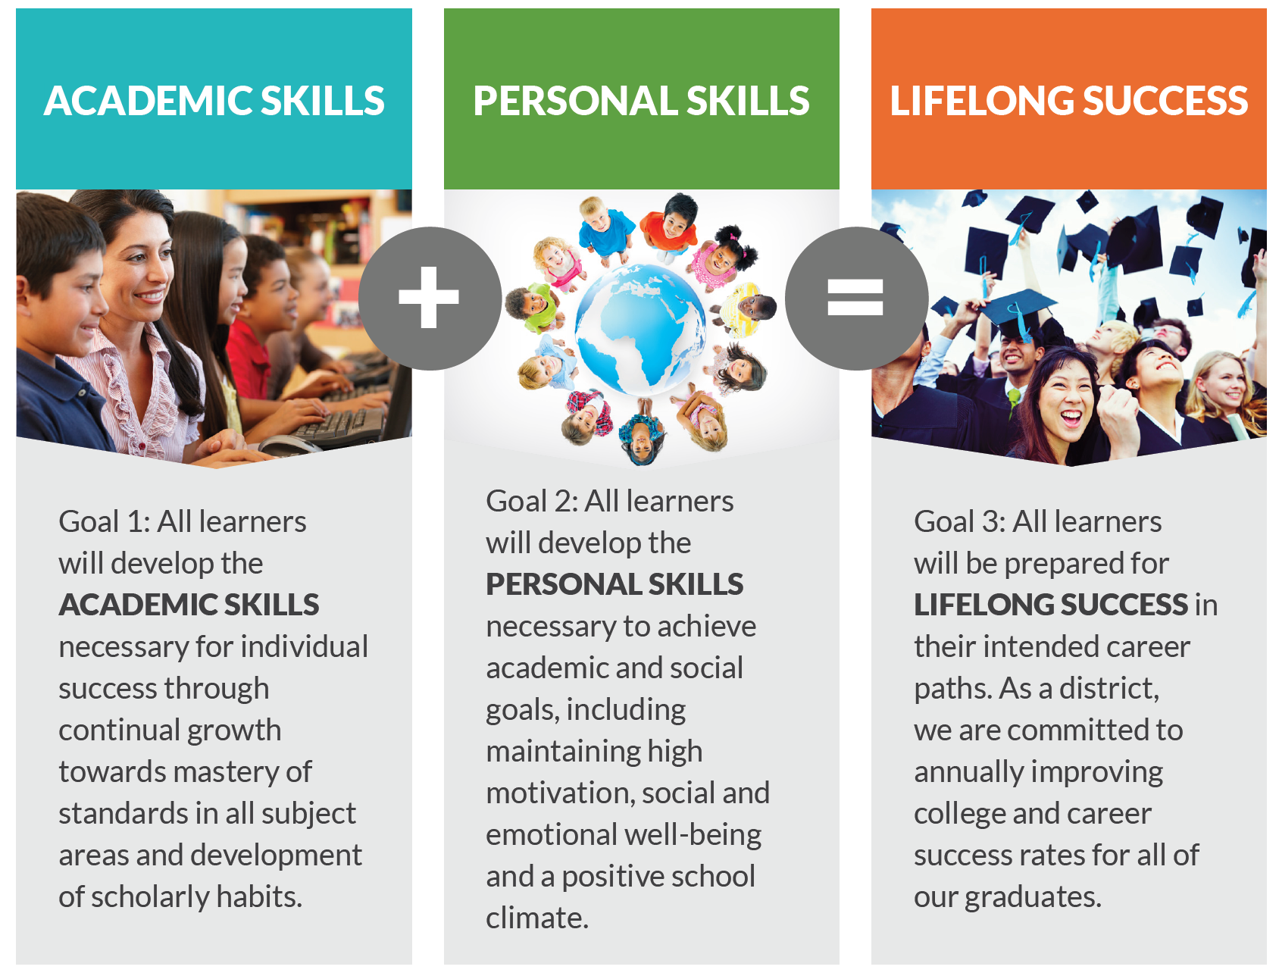
GGUSD Strategic Plan
Notes:
2 min
Here is our GGUSD Strategic Plan. The way we evaluate our students growth on a report card is reflected here in our GGUSD Strategic Plan.
As you click and say- “Standards-based report cards will support and prepare our students on their journey to lifelong success by maintaining their high motivation when they see their continual growth towards mastery of standards.”

Slide 12
Reminder:
Parent Conference Week December 12th -19th

